Slide 1
Registration process and registered pesticide in Nepal
Sahadev Prasad Humagain, Officiating Chief
Plant Quarantine and Pesticide Management Centre
Hariharbhavan, Lalitpur

Slide 2
Coverage
Registration procedure of the pesticides and its role for pesticide management
Registered list of the pesticides (Insecticides, Fungicides, Bactericides, Herbicides and others )
Banned list of pesticides in Nepal

Slide 3
Registration Process
Two methods (Analogous and Comprehensive )
Our registration method : Analogous (registration by the documents)
Advantages of Analogous
Less resources required
Less time consuming
Already registered in other countries, tested and verified
Suitable for underdeveloped countries like Nepal

Slide 4
Cont……
hLjgfzs ljiffbL Joj:yfkg P]g @)&^ sf] bkmf # / hLjgfzs ljiffbL lgodfjnL @)%) sf] lgod # sf] pk–lgod -!_ / -@_ cg';f/ s'g} JolQm, ;+:yf jf lgsfon] cfoft, lgof{t, pTkfbg jf lsga]r ug]{ ljiffbL kl~hs/0f u/fO{ k|df0f kq lngsf nflu ljiffbL kl~hs/0f sfof{nodf lgj]bg lb+bf tklzndf pNn]lvt hfgsf/Lo'Qm sfuhkqx? lgj]bg ;fy clgjfo{ ?kdf k]z ug'{kg]{5 .
!= ljiffbL kl~hs/0fsf nflu ;ldltn] tf]lslbPsf] 9fFrfdf ?= !) sf] l6s6 ;lxtsf] lgj]bg . (Application Form for Registration of Pesticide with 10 Rupees Ticket)
@= kl~hs/0f b:t'/ ?= !))).— (Registration Fee Rs. 1000/-)

Slide 5
Cont
#= ljiffbLsf] cfoft tyf lalqm lat/0f ug{sf nflu sDkgLn] lbPsf] cflwsfl/s ljt/s kq . (Letter of Authorization)
$= g]kfndf pQm ljiffbLsf] k|of]u cfjZos 5 eGg] k'i6\ofO{ . (Statement of the need to use in Nepal)
%= ;+lIfKt ?kdf ljiffbLsf] k|of]u ljlw v'n]sf] sfuhkq . (Summary of Intended Use Pattern)

Slide 6
Cont
^= jftfj/0fdf ljiffbLsf] laiffn['kgf ;DaGwL ljj/0f . (Ecotoxicological Data)
&= ljiffbLsf] k|efjsfl/tf ;DaGwL ljj/0f . (Efficacy Data)
*= ljiffbLsf] cjz]if laZn]if0f ljj/0f . (Residue Analysis)
(= ef/t jf t]>f] d'n'sdf ljiffbL kl~hs/0f ul/Psf] k|df0f kqsf] k|ltlnlk . (Copies of Foreign Registration Certificate)

Slide 7
Cont
!)= ljiffbL cfoft, pTkfbg jf lsga]r ubf{ k|of]u ul/g] ;"rskq – # k|lt . (3 Copies of the Original Label)
!!= cfoft ul/g] ljiffbLsf] cg'df]lbt ;"rskq . (Approved Labels)
!@= g]kfndf cfoft ul/g] ljiffbLsf] g]kfnL efiffdf tof/ ul/Psf] krf{ . (Leaflets in Nepali Language)
!#= g]kfndf pTkfbg / ;+Zn]if0f ul/g] ljiffbLsf] g]kfnL efiffdf tof/ ul/Psf] ;"rskq / krf{ . (Labels and Leaflets in Nepali Language)

Slide 8
Post stamp
To,
Chief
Plant Quarantine and Pesticide Management Centre
Hariharbhawan, Lalitpur, Nepal
I / we hereby submit this application for the Registration/ Re(registration of the pesticide for the objective as specified below. I agree to abide by the rules and regulations framed under the Pesticide Act, 1991 and the Pesticide Rules, 1993. I agree that any contravention to Act and Regulations shall be subject to penalty.

Slide 9
1. Name and Address of Company :
Name: ... … Postal Address : ... ... ... ... ... ...
VDC/Municipality: ... ... ...... … Ward No: ... ... District: ..................
Telephone: ... ... ... ... Fax: ... ... … Email : ... ... ... ... …...
2. Objective of Registration (Tick Whichever applies) :
( ) Import ( ) Export ( ) Production ( ) Formulation
3. Purpose of Use (Tick whichever applies
3.1 General: ( ) Agricultural, ( ) Public Health, ( ) Sale, ( ) Private Use, ( ) Other use (Specify)
3.2 Research : ( ) Agricultural, ( ) Public Health, ( ) Other use (Specify) ................................
Name of Pesticide :
(a) Trade Name:…Old Registration No . (if regd before and also mention old stock):………...............
(b) Common Name : ... ... ... ... ... ... ... ...
(c) Chemical family (eg Organophosphate, Carbamate, etc): .........

Slide 10
5. Chemical Name (Including empirical formula and molecular weight¹) : ... ... ... ... ... ... ... ... ... ... ... ... ... ... ... ... ... ... ... ... ... ... ... ... ... ...
6. Pure Active Ingredient :
Melting Point : ... ... ... Boiling Point : ... ... ...
Density² …………………… Solubility³ : ... ... ... ... ...
Active ingredient contents (g/L or g/kg) : Minimum:………. Maximum: ………
7. Name and Address of Manufacturer : ... ... ……………………………………
8. The pesticide meets the followings specifications (Indicate with a tick) : ( ) FAO Specification
( ) WHO Specification ( ) Any Other............ Identity of Specification)

Slide 11
Formulated Product :
9.1 Formulator's name and address : ... ... ... ... ... ...
9.2 Type of formulation : ... ... ... ...
9.3 Use category (Tick Whichever applies): ( ) Insecticide ( ) Acaricide
( )Herbicide ( )Fungicide ( ) Biopesticide ( ) Rodenticide
( ) Botanical pesticide ( )Other (Specify) : ... . ... ...
9.4 Concentration of technical active ingredient(s) (g/kg or g/L) : ... .
9.5 Physical/ Chemical properties of formulated products :
Color : ... Odor : ... ... Density : .. ... Flammability: ... ... .
If there are more than one active ingredients, information on each should be given.
Describe whether the product is flammable or not.

Slide 12
Recommended Waiting Period so that the residue remaining on the crop at harvest is within acceptable limits:.....................................
11. Particulars where this pesticide is registered for use in any other country.
a) Country:.....................
Trade name of Pesticide : ..........................
Formulation of Pesticide : .........................
Uses allowed : ............................................
Country:.....................
Trade name of Pesticide : ..........................
Formulation of Pesticide : .........................
Uses allowed : ............................................

Slide 13
12. LD₅₀ of the active ingredient : (Oral and Dermal) .......... LC ₅₀:
Poisoning Symptoms and Antidote Statement :................
Container: Type : … Sizes : ... ... .
15. WHO Classification (Indicate which applies) :
( ) IA Extremely hazardous ( ) IB Highly Hazardous
( ) II Moderately hazardous ( ) III Slightly hazardous
( ) IV Non-hazardous
Lethal dose of the pesticides (Data transferable).
Describe pesticide container material and size.

Slide 14
16. Storage of pesticide: ... ... ... …. ... ...
I /We ………………. ………… …………..., the applicant, hereby declared that all the information that have given in this application, to the best of my/our knowledge, are true and correct.
(Signature and Name of Applicant)
(For and on behalf of) (Date) (Designation) (Affix seal or stamp of Applicant)
Describe the storage facility, where and how you are going to store the pesticides.

Slide 15
Summary of Registerd Pesticides (up to 2075/08/30 or December 15,2018)
SN | Pesticides | Trade Name | Common Name
1 | Insecticide | 1635 | 59
2 | Acaricide | 28 | 6
3 | Fungicide | 746 | 42
4 | Bactericide | 17 | 1
5 | Herbicide | 436 | 30
6 | Rodenticide | 38 | 2
7 | Molluscicide | 2 | 1
8 | Biopesticide | 113 | 14
9 | Nematicide | 1 | 1
10 | Herbal | 19 | 13
 | Total | 3035 | 169

Slide 16
 | @)&% d+l;/ d;fGt;Dd ljiffbL Joj;fodf ;+nUg Joj;foLx?sf] ljj/0f
qm=;+= | ljj/0f |  |  | ;+Vof
1 | kl~hs[t ljiffbLsf] ;+Vof -Aofkf/Ls gfd_ |  |  | 3035
2 | kl~hs[t ljiffbLsf] ;+Vof -;fdfGo gfd_ |  |  | 169
3 | laiffbL v'b|f las|]tf O{hfht kq k|fKt ug]{x/sf] s'n ;+Vof |  |  | 14849
4 | ljiffbLsf] ;'/lIft e08f/0f tyf k|of]usf] tflnd k|fKt ul/ k|df0f–kq k|fKt ug]{x?sf] ;+Vof |  |  | 13012
5 | O{hfht lnPsf ljiffbL ;+Zn]ifn0fstf{x?sf] ;+Vof |  |  | 5
6 | ljiffbL 5s{g] Joj;foLx?sf] k|df0f–kq k|fKt ug]{sf] ;+Vof |  |  | 28
7 | ljiffbL cfoft stf{x?sf] ;+Vof |  |  | 253

Slide 17
Registered Pesticide list
List of technical name of pesticides upto 2075/08/30
Insecticide

Slide 18
S.N. | Common Name
1 | Abamectin
2 | Acephate
3 | Acetamiprid
4 | Alphacypermethrin
5 | Alphamethrin
6 | Aluminium Phosphide
7 | Amitrazz
8 | Azamethiphos
9 | Beta-Cyfluthrin
10 | Bifenthrin
11 | Buprofezin
12 | Carbaryl
13 | Carbofuran
14 | Carbosulfan

Slide 19
15 | Cartap Hydrochloride
16 | Chlorantraniliprole
17 | Chlorfenapyr
18 | Chlorfluazuron
19 | Chlorpyrifos
20 | Cyfluthrin
21 | Cypermethrin
22 | Cyromazine
23 | Dazomet
24 | Deltamethrin
25 | Diafenthiuron
26 | Dichlorvos
27 | Diflubenzuron
28 | Dimethoate

Slide 20
29 | Dinotefuran
30 | Emamectin benzoate
31 | Ethion
32 | Etofenprox
33 | Fenvalerate
34 | Fipronil
35 | Flonicamid
36 | Flubendiamide
37 | Flumethrin
38 | Fluralaner
39 | Imidacloprid
40 | Indoxacarb

Slide 21
41 | Lambda cyhalothrin
42 | Lufenuron
43 | Malathion
44 | Nitenpyram
45 | Novaluron

Slide 22
46 | Permethrin
47 | Phenthoate
48 | Profenofos
49 | Propoxur
50 | Pymetrozin
51 | Quinalphos
52 | Spinosad
53 | Spiromesifen
54 | Spirotetreamat
55 | Temephos
56 | Thiacloprid
57 | Thiamethoxam
58 | Thiodicarb
59 | Triazophos

Slide 23
2. Acaricide
S.N. | Common Name
1 | Bifenazate
2 | Dicofol
3 | Fenazaquin
4 | Fenpyroximate
5 | Hexythiazox
6 | Propargite

Slide 24
3. Nematicide
S.N. | Common Name
1 | Fosthiazate

Slide 25
4. Fungicide
S.N. | Common Name
1 | Ametoctradin
2 | Azoxystrobin
3 | Benomyl
4 | Captan
5 | Carbendazim
6 | Carboxin
7 | Chlorothalonil
8 | Copper hydrochloride
9 | Copper hydroxide
10 | Copper oxychloride
11 | Cymoxanil
12 | Difenoconazole
13 | Dimethomorph

Slide 26
14 | Dinocap
15 | Famoxadone
16 | Fenamidone
17 | Fluazinam
18 | Flusilazole
19 | Flusulphamide
20 | Fungous Proteoglycan

Slide 27
21 | Hexaconazole
22 | Hymexazol
23 | Iprobenfos
24 | Iprovalicarb
25 | Kasugamycin
26 | Kresoxim Methyl
27 | Mancozeb
28 | Metalaxyl
29 | Metiram
30 | Pencycuron
31 | Propiconazole
32 | Propineb
33 | Sulphur

Slide 28
34 | Tebuconazole
35 | Thiadiazole - Copper
36 | Thifluzamide
37 | Thiophanate Methyl
38 | Thiram
39 | Tricyclazole
40 | Trifloxystrobin
41 | Validamycin
42 | Zineb

Slide 29
5. Bactericide
S.N. | Common Name
1 | Streptomycin sulphate + Tetracyclin Hydrochloride

Slide 30
6. Herbicide
S.N. | Common Name
1 | 2,4- D Sodium salt
2 | 2,4-D Ethyal Ester
3 | Acetochlor
4 | Ammoium salt of Glyphosate
5 | Atrazine
6 | Bensulforun Methyl
7 | Bispyibac sodium
8 | Butachlor
9 | Chlorimuron
10 | Clodinafop propargyl
11 | Glufosinate

Slide 31
12 | Glyphosate
13 | Mesotrione
14 | Metribuzin
15 | Metsulfuron Methyl
16 | Oxadiargyl
17 | Oxyfluorfen
18 | Paraquat
19 | Paraquat dichloride
20 | Pendimethalin
21 | Penoxsulam
22 | Piroxofop- Propanyl

Slide 32
23 | Pretilachlor
24 | Propaquizafop
25 | Pyrazosulfuron ethyl
26 | Quizalofop-ethyl
27 | Quizalofop-P-Tefuryl
28 | Simetryn
29 | Sulfosulfuron Methyl
30 | Tembotrine

Slide 33
7.Rodenticide
S.N. | Common Name
1 | Bromadiolone
2 | Zinc Phosphide

Slide 34
8. Molluscicide
S.N. | Common Name
1 | Metaldehyde

Slide 35
9. Biopesticide
S.N. | Common Name
1 | Azadirachtin
2 | Bacillus amyloliquefaciens D 203
3 | Bacillus subtilis
4 | Bacillus thuringiensis
5 | Beauveria bassiana
6 | Heterorhabditis Indica (Nematicide)
7 | Metarhizium anisopliae
8 | Nuclear Polyhedrosis Virus
9 | Paecilomyces lilacinus
10 | Paecilomyces SPP (Nematicide)
11 | Pseudomonas fluorescens
12 | Trichoderma harzianum
13 | Trichoderma viride
14 | Verticillium lecanii

Slide 36
10. Herbal
S.N. | Common Name
1 | Chitosan
2 | Kungluang Samunpri
3 | Samunpri Chai Mouses
4 | 30 Ayurvedic Ingredients
5 | Antibacterial & Antifungal Natural Extract
6 | Bio - Bactericide & Bio- - Fungicides
7 | Bio - Bactericide & Bio- - Fungicides - 100% WP(Germination)
8 | Botanical Extract
9 | Botanical Extract for nematodes
10 | Botanical Extract for virus
11 | Herbal Extract Pest Management
12 | Multiplex Bio Strake -100%ml
13 | Virus Management , Neem leaf Extract

Slide 37
List of banned pesticides in Nepal
S. N. | Name of pesticide | Category | Classification | Toxicity | Remarks
1 | Chlordane | POPs | OC | II
2 | DDT | POPs | OC | II
3 | Dieldrin | POPs | OC | O
4 | Endrin | POPs | OC | O
5 | Aldrin | POPs | OC | O
6 | Heptachlor | POPs | OC | O
7 | Toxafen | POPs | OC | O
8 | Mirex | POPs | OC | O
9 | Lindane | POPs | OC | II
10 | BHC | POPs | OC | II
11 | Phosphamidon | PIC | OP | Ia | 7
12 | Organo mercury fungicides | EMC, MEMC, PMA, PMC | Mercury | O
13 | Methyl parathion | PIC | OP | Ia | 14mg/kg
14 | Monocrotophos | PIC | OP | Ib | 14
15 | Endosulfan* | POPs | OC | II
16 | Phorate |  | OP | Ia

Slide 38
List of banned pesticides in Nepal
S. N. | Name of pesticide | Category | Classification | Toxicity | Remarks
17 | Dichlorvos |  | Organophosphate | IB | 2075/09/16 Pesticide committee has decided to banned and process for notification
18 | Carbofuran |  | Carbamate | IB
19 | Carbaril |  | Carbamate
20 | Benomyl
21 | Triazophos |  | Organophosphate
22 | Carbosulfan |  | Carbamate
23 | Dicofol |  | Organochlorine
24 | Aluminium phosphide 3 gm tablet

Slide 39
Registered Pesticide for the FAW
S. No | Name of Pesticide | Trade name no. | Registration
1 | Emamectin Benzoate 5 % EC | 46 | Nepal Agro Industries, Plant remedies Nepal, Singh Agro centre, Birgunj Beej Bhandar, Agricare Nepal Pvt. Ltd., Nisha Trading, Greenland Traders etc.
2 | Spinetoram | 1 DELEGATE | Krishak Beej Bhandar, Birgunj
3 | Chlorantranilprole | 6 | Global Agro Trading, Nepal Agro Industries etc
4 | Spinosad | 2 | Global Agro Trading, Krishak Beej Bhandar, Birgunj Divas Enterprises

Slide 40
For More Information
www.npponepal.gov.np

Slide 41
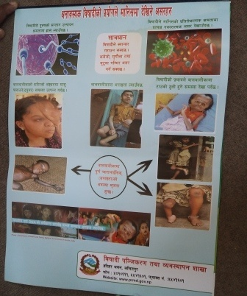
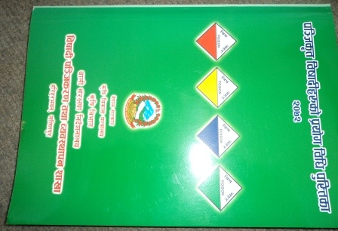
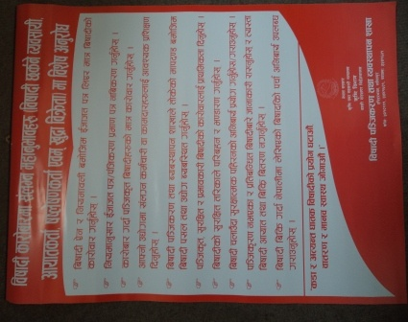
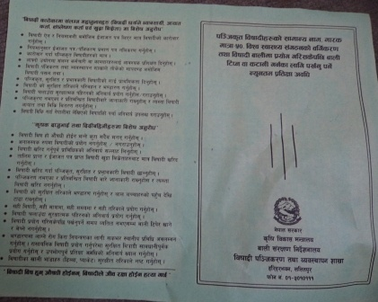

Slide 42
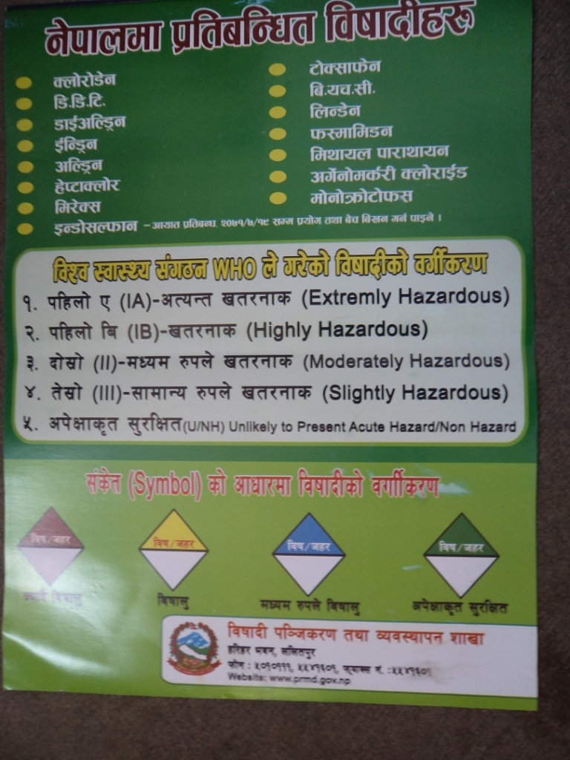

Slide 43
