Slide 1
Management of Fall Armyworm (Spodoptera frugiperda)
Sahadev Prasad Humagain
Officiating Chief
Mahesh Chandra Acharya
Senior Plant Protection Officer
Plant Quarantine and Pesticide Management Center
Hariharbhawan, Lalitpur.

Slide 2
Background
New agricultural pests are periodically introduced into agricultural environment and pose some degree of risk, a number of characteristic factors make FAW a more devastating pest than many others
as it consumes many different crops including maize;
spreads quickly across large geographic areas and
may persist throughout the year in some warm climate areas.
In addition to emerging economic and food security impacts, responses to the pest are potential for
negative health impacts on human animal and environment
as a result of extensive, indiscriminate, and unguided use of synthetic pesticides.

Slide 3
Background
Need of Development and implementation of coordinated, evidence-based efforts
Scouting by farming communities and effective monitoring mechanism are limited.
The lack of surveillance, monitoring, and scouting capacity, delayed efforts to determine the management strategies.
Efforts to suppress the pest are usually based the application of synthetic pesticides.
Education, research, and regulatory processes
Management approach against FAW need to be
informed by sound scientific evidence, build on past experience combating FAW in other parts of the world, and be adaptable to low-resource smallholders.
An Integrated Pest Management (IPM) approach provides a useful framework to achieve these goals.

Slide 4
FAW Management

Slide 5
1. Seeds and varieties:
Quality seed and FAW resistant varieties (if available).
Seed treatment with Imidachlorpid 48% FS @ 4 ml/kg seed
Select that type of variety in which husk fully covers the cob.

Slide 6
2. Cultural management practices
Avoid late and staggered planting. Early planting helps to escape the peak migration of FAW adults.
Maintain vigor of plants
Ploughing the field to a depth of at least 10
Maintain plant diversity for increasing the presence of natural enemies.

Slide 7
2. Cultural management practices..
Adoption of Push-pull technology
Desmodium grass and other legume crops such as pigeon pea, beans, groundnuts as inter-crops for push,
Border crop of Napier grass for pull of the FAW.
Destroy crop residues after harvest for destroying eggs, larvae and pupae of FAW.
Crop rotation with alternate crops to reduce the attack of FAW.

Slide 8
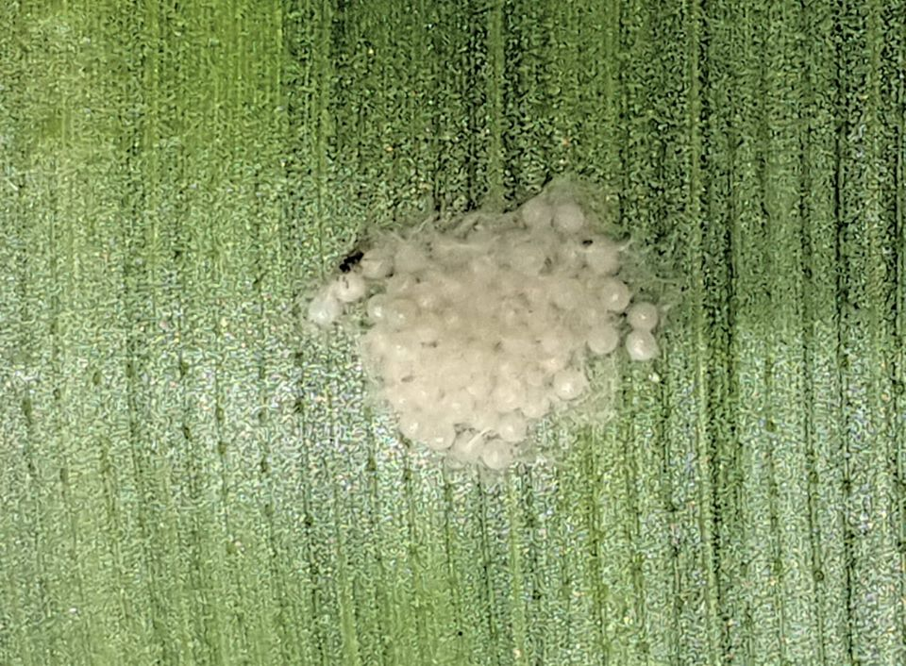
3. Mechanical control
Hand picking and crushing of egg masses and young larvae or immerse them into soap water.

Slide 9
4. Biological control
Different species of naturally-occurring bio-control agents have been established and acting upon the related species of FAW in Nepal, can also help to suppress FAW.

Slide 10
4.1 Predators:
Predatory insects and arachnids include Earwigs (Dermaptera: Forficulidae, Carcinophoridae), Ladybird beetles (Coleoptera: Coccinellidae), Ground beetles (Coleoptera: Carabidae), Assassin and flower bugs (Hemiptera: Reduviidae, Pentatomidae, Geocoridae, Nabidae, Anthocoridae), Eusocial, solitary and other predatory wasps (Hymenoptera: Vespoidea), Spiders (Arachnida: Araneae), Ants (Hymenoptera: Formicidae), Birds and bats

Slide 11
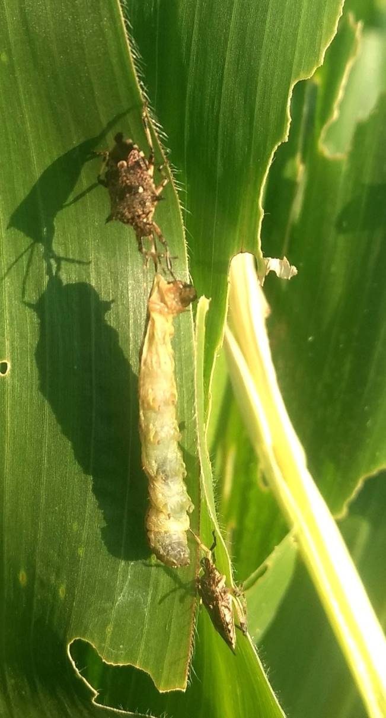
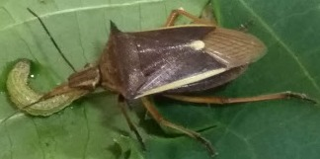
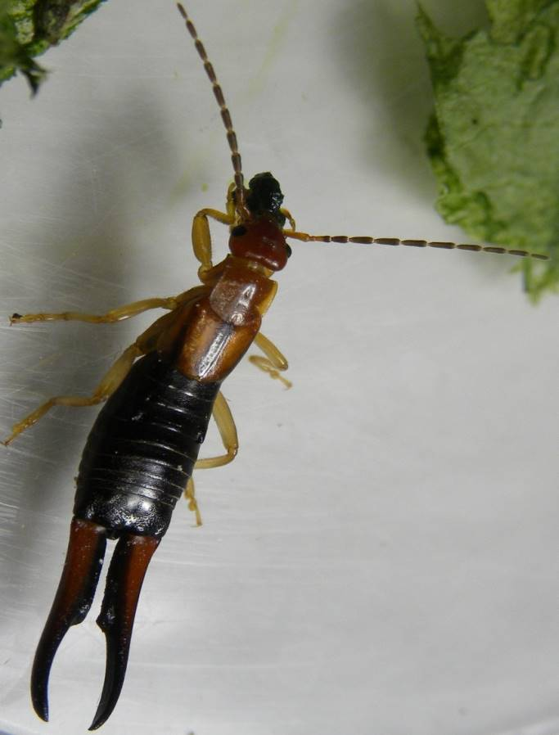
Naturally occurring predators
Andrallus spinidens
Eocanthecona furcellata
Earwig Forficula sp.

Slide 12
4.2 Parasitoids:
These include Telenomus remus Nixon (Hymenoptera: Platygastridae), Chelonus insularis Cresson (Hymenoptera: Braconidae), Cotesia marginiventris Cresson (Hymenoptera: Braconidae), Trichogramma spp. (Hymenoptera: Trichogrammatidae), Fly parasitoids: Archytas, Winthemia and Lespesia (Diptera: Tachinidae).
FAW can also be managed by the release of parasitoids Trichogramma chilonis or T. pretiosum @100000/ha., Telenomus remus @ 50000/ha and Bracon hebetor @ 50,000/ha.

Slide 13
Trichogramma pretiosum and Telenomus remeus: potential indigenous parasitoids

Slide 14
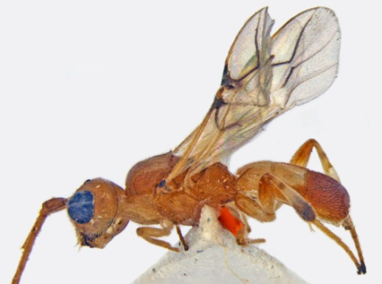
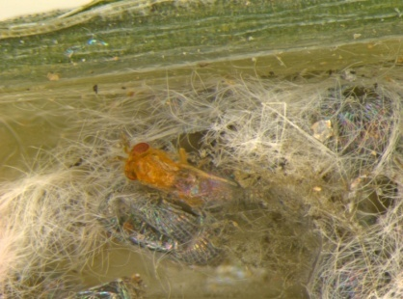
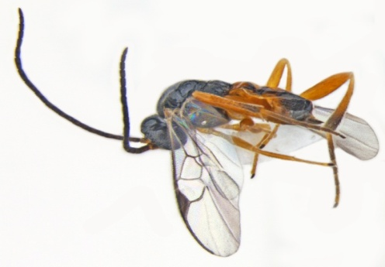
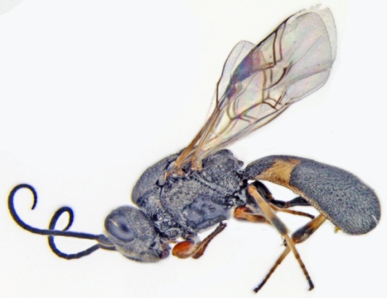
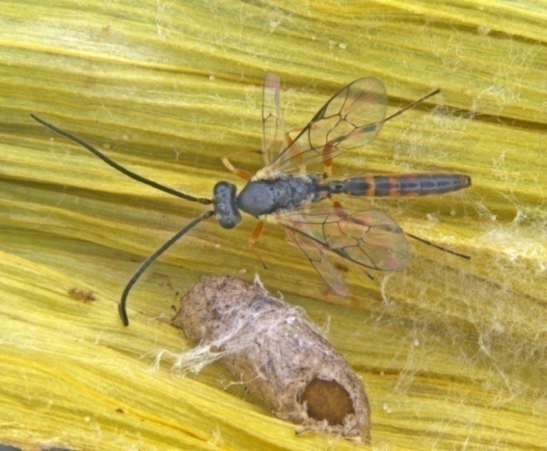
Parasitoids of FAW
Larval Braconidae parasitoids
Egg Parasitoids
Glyptapanteles creatonoti
Phanerotoma sp.
Trichogramma sp.
Telenomus sp.
Larval-pupal Ichneumonidae parasitoid
Chelonus sp.
Solitary larval Ichneumonid parasitoid
Campoletis chlorideae
Trichomalopsis sp. (Pteromalidae) (from pupae)

Slide 15
4.3 Parasites and microbial pathogens:
These are nematodes, fungi, bacteria, viruses and protozoa, which cause lethal infections to FAW. Potential microbial agents against FAW can be NPV, MNPV, BT, Nomuraea rileyi and Entomopathogenic Nematodes (Heterorhabditis, Steinernema).
Some recommended biopesticides are Bacillus thuringiensis (2-3 g/liter) and Metarhizium anisopliae (2 g/liter)

Slide 16
Nomuraea rileyi infected FAW larvae
Spodoptera frugiperda NPV
Nomuraea rileyi observed to cause epizootics on FAW in Shivamogga, Chikkaballapur, Bangalore districts of Karnataka because of very favourable temperature (25°C) & RH (> 70%) prevailing in these areas
Infected larvae showed extensive green sporulation (10¹⁰ to 10¹¹ Spores per each cadaver)

Slide 17
5. Other management options
Use of local botanicals (neem, hot pepper, titepati, and other plant extracts)
Sugary sprays, oil, ‘fish soup’ or other material to attract ants and wasps to the maize plants.

Slide 18
6. Use of botanical Pesticides:
Use of botanical pesticides: Neem based insecticides are effective against the larvae of upto 3rd instar. Use Azadirachtin 1500 ppm @ 5 ml per liter of water at the time of early stage of damages.

Slide 19
7. Use of Chemical pesticides
Pesticides should be effective, low-risk, economical, accessible and user friendly.
Following points need to be considered:
Avoid the use of highly hazardous pesticides
When the pest infestation reaches the action threshold level, there may be the need of pesticide application.
Time of pesticide application: For the pesticides to be effective spray early in the morning from 6:00-10:00am or late afternoon 4:00-7:00pm provided the conditions are favourable for spraying because FAW actively feeds at night.

Slide 20
Early age of the crop is more susceptible to FAW infestation thus action thresholds at different ages may differ.
Growth stages and action threshold:
S.N. | Crop age | Action threshold
 | From emergence to 4 weeks | 5% infestation
 | From 5 to 7 weeks after emergence | 10% infestation (newly emerged 3 leaves-freshly damaged)
 | From 8 weeks onwards (Tasseling to near maturity) | 10% ear damage

Slide 21
7. Use of Chemical pesticides cont….
Method of application:
Use PPE while handling and using pesticides.
Follow the instructions given on the product label.
Always use a clean pump and clean water for mixing the pesticides.
Spray the whole plant and target the whorl where the larvae are usually found.
Avoid spraying when it is windy or if rain is imminent.
Frequency of application of pesticides: Spray pesticide and check the presence of larvae 4 days after spraying. Second spray after 2-3 weeks may be necessary with alternate group of pesticide to avoid development of pest resistance.

Slide 22
7. Use of Chemical pesticides cont….
Frequency of application of pesticides:
Spray pesticide and check the presence of larvae 4 days after spraying.
Second spray after 2-3 weeks may be necessary with alternate group of pesticide to avoid development of pest resistance.

Slide 23
7. Use of Chemical pesticides cont….
Some of the recommended chemical pesticides and their doses are as follows:
Spinetoram 11.7 SC (Delegate) @ 0.5 ml/liter
Chlorantraniliprole 18.5% SC @ 0.4 ml/liter
Spinosad 45%SC @ 0.3 ml/liter
Emamectin benzoate 5% SG @ 0.4 g/liter

Slide 24
8. FFS Approach for farmers' education on FAW
Farmers Field School (FFS) is a widely used extension approach to educate farmers in agriculture.
This approach was initiated in Nepal with the FAO supported TCP project on Community IPM in 1998 for the integrated management of Brown Plant Hopper.
In addition, FFS curricula have been developed for the integrated pest management in different crops including maize.

Slide 25
Different levels facilitators (Officers, assistant level staff and farmers) have been developed which can be used to run the FFS for the management of FAW.
The FFS curriculum for maize can be revised and updated focusing on the integrated management of FAW.
As part of the FAW management strategy to reach rural communities affected by FAW,
FFS will be combined with
mass information campaigns, rural radio, and participatory videos,
community action plans for FAW management and
short field courses for farmers and rural advisors based on experiential learning.

Slide 26
Annexure 3: List of Pesticides that can be used for the Management of FAW
S N | Common Name | Registered Trade Names | Remarks
 | Azadirachta indica | MARGO N.F
2. | Azadirachtin | AGRIGAURD, ASTAN-KILLER- 0.15 EC, ASTHA NEEM SUPER- 1 Cake, AVANA- 0.15 GR, AZADIRECHTIN- 1 EC, BELIEVE- 0.03 EC, BIO - M – POWER- 0.03 WW, BIO DOSE- 0.15 WW, BLACK DOG- 5 EC, MARGOSOM-MULTINEEM- 0.03 EC, MULTINEMOR-0.15 EC, NEEM 1500-0.15 EC, NEEM- F, NEEM GOLD-0.04 GR, NEEM KAVACH-0.15 EC, NEEMATE -10-10 GR, NEEMAZAL-5 EC, NEEMCIDE-0.03 EC, Neemraj- 1%, 5%, 0.03%, 0.15% EC, Neemras 1500 PPM-0.15% EC, Neemtel 1.5 % EC, Neemtel 1- 3% EC, Niconeem- 0.15%, 0.3%, Niconeem 1% EC, Nimazal—TS- 1% EC, Nimbecidine-0.03% EC, Peak Neem 0.03% EC, Refresh 0.03% EC, Signature Gold 1% EC, Superneem+ 0.15% EC, Ultineem 1% EC

Slide 27
3. | Bacillus thuringiensis | CHANDANI - 5 WP, LIPEL, MAHASTRA- 0.5 WP
4. | Chlorantranilipole 18.5% SC | ALLCORA (18.50 %SC), ALLCORA - G (0.4% GR), COVER LIQ (0.4% GR), NICORA GOLD (18.5% SC), CORAGEN (18.50% SC), FERTERRA (0.4 % GR)
5. | Emamectin benzoate | ABERKILLER (2% EC), ALLCLAIM (5% SC), AVER KILLER(5% WDG) , AVER KILLER (2% SC), BILLO (1.9% EC), B-KILL (5% WDG) , BOXER (5% SG) , CHEMDOOT (5% SG), COBRA (5% WDG), CROP – STAR (5% WDG), DRAGON (5% SG), ELPIDA (1.9 SG) EM-1 (5% SG), EMA STAR (5 % WDG), EMA STAR (6 % WDG) , EMACTO (5% SG), EMAR (5% EC), EMAR SUPER (5.7 WDG), EMAVAP (2%EC) , EMSTAR – 5 (5% SG), EMVAP (5% SG), FITREST (5 %SG), G - SUPER (5% EC), G - TOP (2% EC), JAPONICA (1.9% EC), JEMSTAR (5.7 % SG), KI - STAR (5% SG), KI - STAR (5.7% WDG), KING STAR (5 SG), KRI - STAR - 5 (5% SG), LARBOTIN (5% SG), MISSILE (5% SC), N-STAR (5% WDG), N-STAR (5.7 % WDG), PROCLAIM (5% SG), RANGE (2.15% EC), REAL STAR (5% SC), REAL STAR - X (5% SG), REALSTAR (5%WDG), RUDRA ( 5% SG), SAFARI (5% SG), SNAKE VENOM (5% WSG), SUPER STAR(5% SG}, TOP KILLER ( 5.7% WDG), TRUST (5% SG), YODHA (5% SG)

Slide 28
6 | Metarhizium anisopliae | BIOCIDE MANIC, EMERALD, KALICHAKRA, PACER, PEAK MOTI, RECHARGE, VARUNASTRA
7 | Spinetoram 11.7 SC | Delegate (11.7 % SC) | Registered in 2019
8 | Spinosad | Tracer (24% EC), Tracer (45% SC),

Slide 29
Knowledge and skills to be provided on the short course for already trained FFS Facilitators.
Describe the different crop-development stages
Know IPM principles and why they are important for good management
Know how to monitor all elements of the agro-ecosystem, understand relations and interactions between the elements, as a basis for decisions on field management (Agro-Ecosystem Analysis, AESA)
Describe plant compensation and its importance
Know ecological function and life cycles of main pests and natural enemies with focus on FAW; be able to recognize and distinguish different pests and natural enemies
Recognize major diseases, the conditions that favor their development, and possible damage they can cause
Know the different management options against FAW
Understand toxicity of different pesticides and how to reduce exposure and use
Describe effects of pesticides on human health, natural enemies, environment
Know how to collect information for economic analysis comparing farmers’ local practice and IPM practice

