Slide 1
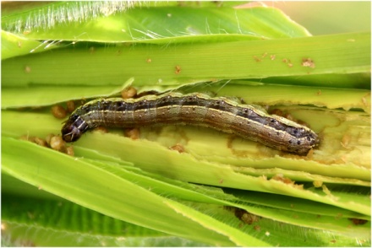
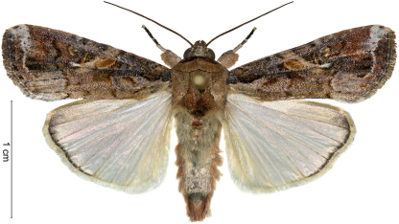
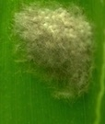
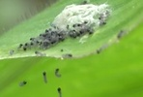
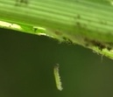
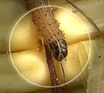
FALL ARMYWORM (SPODOPTERA FRUGIPERDA) MONITORING AND SCOUTING IN MAIZE FIELD
SAMUDRA LAL JOSHI, PhD
FORMER PRINCIPAL SCIENTIST (ENTOMOLOGY)
NEPAL AGRICULTURAL RESEARCH COUNCIL
FAW TECHNICAL COMMITTEE, MINISTRY OF AGRICULTURE AND LIVESTOCK DEVELOPMENT
VENUE: ENTOMOLOGY DIVISION, NARC, KHUMALTAR
06-01-2076 (SEPT. 18, 2019)

Slide 2
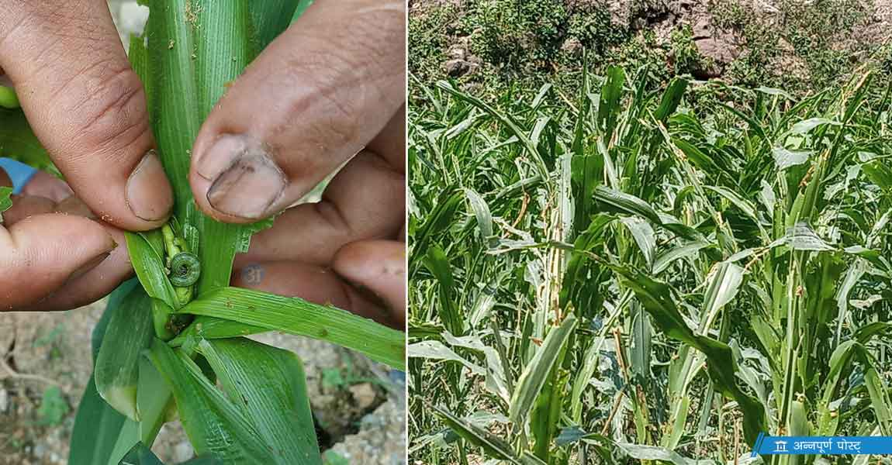
AN INVASION OF AMERICAN ARMYWORM HAS RECENTLY BEEN OCCURRED IN NEPAL
First observed in Sindhuli dist. dated Apr. 28, 2019.
First reported from Gaindakot, Nawalpur, May 9, ’19
NPPO-Nepal authenticated its invasion in Nepal
dated Aug. 12, 2019.

Slide 3
EVER ADDING DISTRICTS IN THE COUNTRY BEING REPORTED OF MAIZE CROP RAMPAGE OF FAW FROM APR. 28 UNTIL SEP. 18, 2019
1. Banke 2. Bhaktapur 3. Chitwan 4. Dailekh 5. Dolakha 6. Kavrepalanchok 7. Khotang 8. Lalitpur 9. Nawalpur 10. Okhaldhunga 11. Pyuthan 12. Ramechhap 13. Rolpa 14. Salyan 15. Sindhuli 16. Sindhupalachok 17. Udaipur 18. ?Dhankuta, 19. ?Jhapa

Slide 4
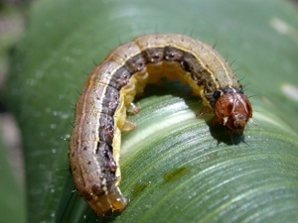
FALL ARMYWORM SPODOPTERA FRUGIPERDA
SOURCE: John Obermeyer Purdue University

Slide 5
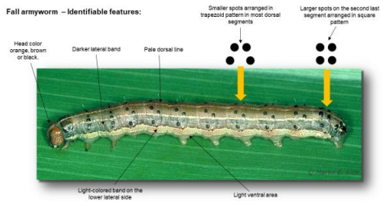
FALL ARMYWORM
IDENTIFIABLE FEATURES

Slide 6
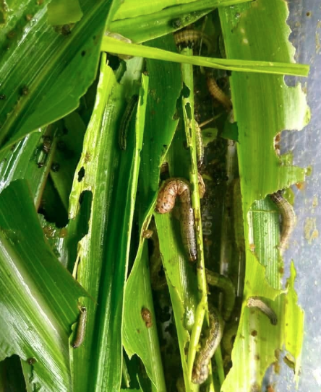
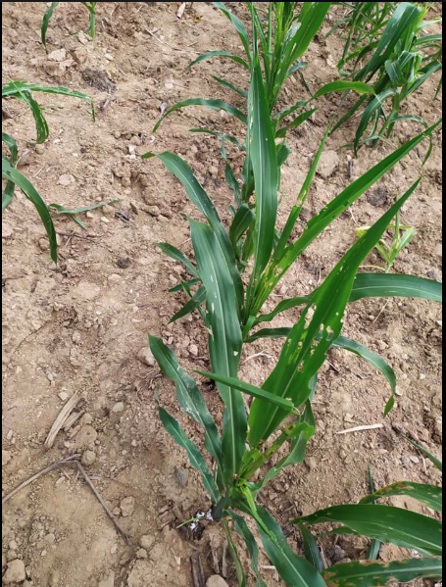
SOME GLIMPSES OF FAW INVASION IN MAIZE CROP IN NEPAL, 2019
RAMECHHAP
SINDHUPALACHOK
DOLAKAHA
OKHALDHUNGA
EXPECTED FAW MAIZE YIELD LOSSES IN THE COUNTRY IS ESTIMATED RS. 85 MILLION.—CIMMYT-NEPAL.

Slide 7
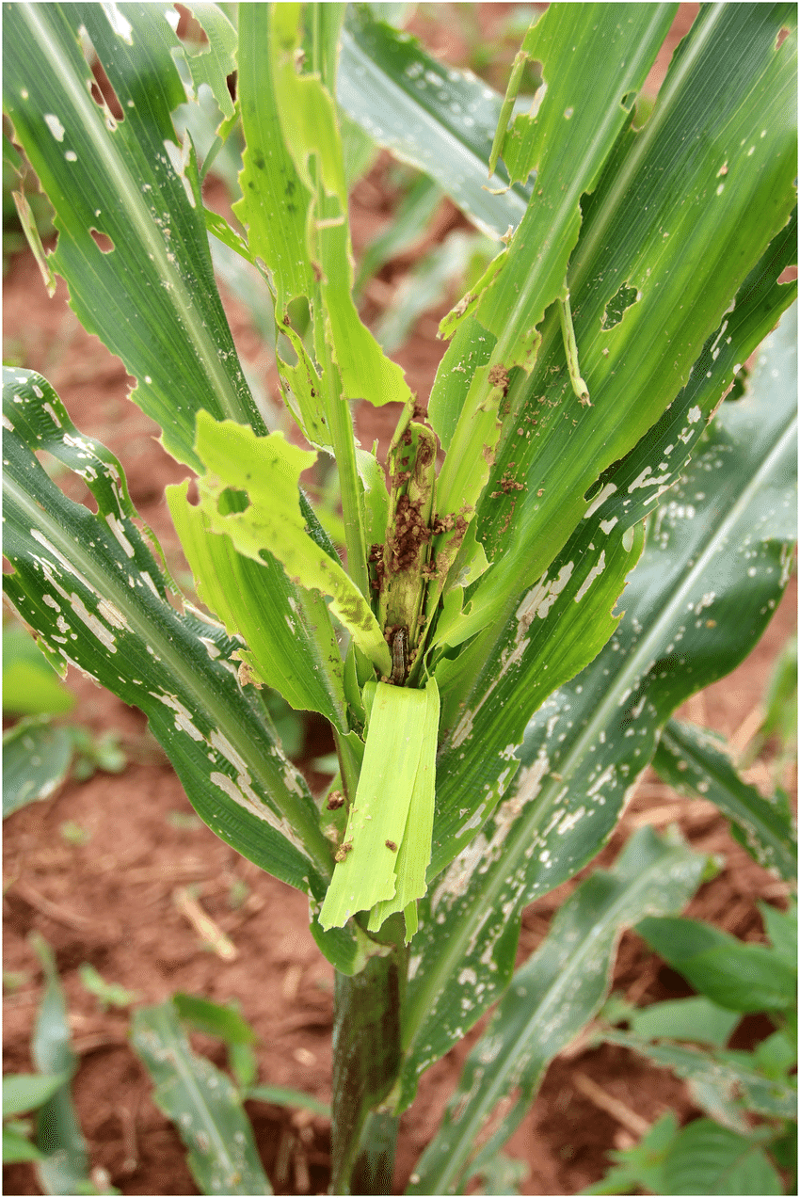
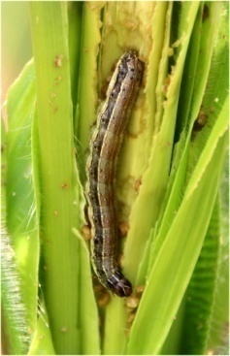
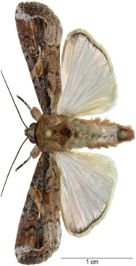
FAW FACTS
FAW (Spodoptera frugiperda; Lepidoptera: Noctuidae)
Native to the Americas
First detected in Nigeria in 2016
Challenging Pest to control
Feeds mainly inside the plant
Long history of resistance to pesticides & GM toxins
Extreme genetic bottleneck
Stewardship needed for long-term management
Wide host range
>80 different crops – flowers; 353 different plant species (Montezano, 2018).
Maize, sorghum & rice most at risk
The FAW is here to stay–learn how to manage it!
Georg Goergen, IITA

Slide 8
FAW FACTS
FAW (Spodoptera frugiperda; Lepidoptera: Noctuidae)
Winter survival of FAW pupal stage - (Pitre & Hogg (1983))
Fall Armyworm does not diapause.
Cannot overwinter in freezing temperatures below 0°C.
Winter survival of FAW pupal stage in Florida
51% survival in southern Florida (18-24°C range) - ENDEMIC
27.5% survival in central Florida
11.6% survival in northern Florida (4.5-18°C range)
The FAW is here to stay–learn how to manage it!
Georg Goergen, IITA

Slide 9
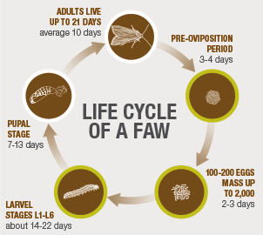
CHALLENGES
High Reproductive Capacity
Long Migration Distances
Short Local Dispersal
Each full generation ~30 days
Pupate in soil at 2 – 8 cm
Does not diapause - dormant state for surviving cold & drought
Adult moths can fly Hundreds of kilometers
Verified accounts of migrations of 1500 km

Slide 10
THE FAW IS HERE TO STAY–LEARN HOW TO MANAGE IT!
EARLY PEST DETECTION FOR EARLY PEST MANAGEMENT
IS THE BEST FITTED STRATEGY.
MONITORING & SCOUTING
OF THE TARGET INSECT PEST SHOULD A REGULAR FIELD PROCESS.

Slide 11
MONITORING
Monitoring is the regular observation
and recording of insect activities
taking place in the plant phenology in
the cropping field.
It is a process of routinely gathering
information on all insect stages during
the growth and development of host
plant.

Slide 12
MONITORING TOOLS
BLACKLIGHT TRAPS
PHEROMONE TRAPS

Slide 13
MONITORING TOOLS
BLACKLIGHT TRAP
15 watt ultraviolet light (uv) lights for
blacklighting endeavors.
The blacklight is perfect to attract noctuid
moths like FAW moths.
The lights can either be placed in a metal
vane above a collecting container with a
killing agent, or they can be hung
downward from the top of a white sheet,
which they illuminate.
The lights are powered by a lawn mower
battery, car battery, or a generator.

Slide 14
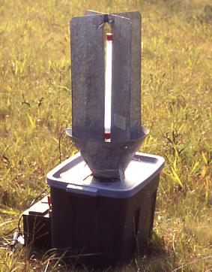
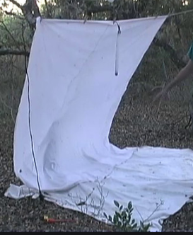
MONITORING TOOLS
USING BLACKLIGHT TRAP IN FIELD
The lights can either be placed in a metal vane above a collecting container with a killing agent (Left), OR they can be hung downward from the top of a white sheet, which they illuminate (Right).

Slide 15
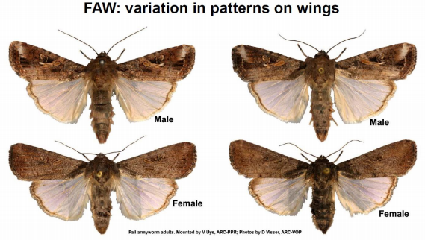
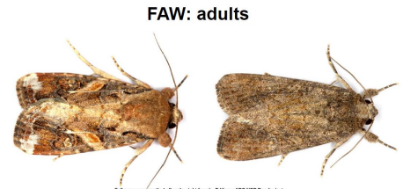
SOME POINTS TO KEEP IN MIND BEFORE
DEPLOYING MONITORING FOR SEASONAL OCCURRENCES OF FAW MOTHS
Know identifiable characteristics of FAW moth.

Slide 16
MONITORING TOOLS
BLACKLIGHT TRAP
15 watt ultraviolet light (uv) is perfect to
attract noctuids like FAW moths.
Both male and female FAW moths are
attracted to light.
Ca. 63% of the captures remained being
females.
Approximately 55% of the females
captured mated 1 or more times as
evidenced by the presence of a
spermatophore in the bursa copulatrix.

Slide 17
MONITORING TOOLS
USING BLACKLIGHT TRAP IN FIELD
Environmental effect on the moth catches
The most important environmental effect on the number of individuals caught in light traps is that of
Temperature,
Wind,
Rainfall and
Moonlight.

Slide 18
MONITORING TOOLS
Moonlight influences moth catches in light trap.
Moonlight reduces the activity of moths and so the active population accessible for the light trap is smaller.
The light of the lamp collects moths from a
smaller area in a moonlit environment.

Slide 19
MONITORING TOOLS
PHEROMONE TRAPS
Sex pheromones for the FAW
Two compounds have been identified as sex
pheromones for the FAW (Sekul and Sparks 1967, 76),
1. (Z)-9-tetradecen-1-ol acetate and
2. (Z)-9-dodecen- 1-ol acetate
(Z) -9 –dodecen -1-ol acetate (Z-9-DDA) is highly
attractive to male FAW in the field (Mitchell and
Doolittle 1976).
When a very high degree of attraction is required
the use of highly purified material is advantageous.

Slide 20
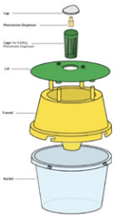
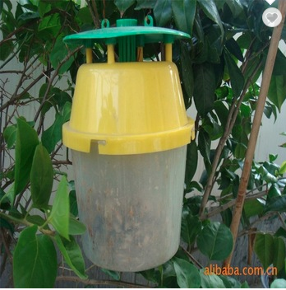
PHEROMONE TRAP
Cap
Lure
Lure basket
Lid
Dismantled
Funnel
BUCKET FUNNEL TYPE
Bucket

Slide 21
COMPANIES PRODUCING
PHEROMONE TRAPS
ISCA Technologies, California, USA.
Russell IPM, England
Pacific Biocontrol Corporation, Vancouver, Washington, USA
Pherobank, The Netherlands.
Novagrica, Paraskevi, Greece
Evergreen Growers Supply, Clackamas, Oregon, USA
Biocontrol Research Laboratory, Bangalore, India

Slide 22
MONITORING TOOLS: PHEROMONE TRAPS
Pheromone traps which attract male armyworm
moths are recommended for maize field
monitoring to observe and record the seasonal
occurrences of moths, which may be used
for FAW forecasting because they are simple to
use.
Traps are place on site during the armyworm
monitoring period which starts in Sep.-Oct. for
most of the time.

Slide 23
MONITORING TOOLS: PHEROMONE TRAPS
If high numbers of moths are caught (more
than 30 males over 3-5 nights) it is an
indication that egg laying is taking place in
the area.
This information is used to advise farmers
to check their fields for young instars and
prepare resources for control.
Traps data is used in conjunction with rainfall
figures to determine specific areas where
outbreaks are likely to occur.

Slide 24
MONITORING METHODOLOGY
Trap selection: Funnel Bucket trap.
Lure selection: FAW Lure, store the extra
lures in a Refrigerator (4-5⁰C), change on
every 4-6 weeks.
Trap placement and setup:
Establish the pheromone trap one month
before planting at a height of approximately
1.25 meters from the ground level.
Place the trap in or next to the maize field
so that the scent of the pheromone is
carried across the tops of the plants by the
wind.

Slide 25
MONITORING METHODOLOGY
Trap placement and setup:
Install the trap in a vertical orientation to
prevent water entering into it, from a long
pole and adjust at least 3 0 cm above plant
height.
Install traps @ 10/ha (1 trap for up to 2 Ropanis
or 3 Kattha).
Trap monitoring and recording:
7-10 days interval throughout the season.
Area-wide and community based approaches.
Weather (temperature, humidity, rainfall, etc.
wherever possible).
Sharing and use of monitoring data.

Slide 26
MONITORING
OFTEN DONE BY USING BLACKLIGHT TRAPS AND
PHEROMONE TRAPS.
PHEROMONE TRAPS ARE VERY EFFICIENT,
SUSPENDED AT CANOPY HEIGHT .
INSECT CATCHES INDICATE THE PRESENCE OF
MOTHS IN THE AREA BUT NOT GOOD INDICATORS OF
DENSITY.
ONCE THE MOTHS ARE DETECTED, SEARCH
(SCOUTING) FOR EGGS AND LARVAE IN THE FIELD.
TO ASSESS THE PROPORTION OF PLANTS INFESTED,
RANDOM SAMPLING OF 20 PLANTS IN FIVE
LOCATIONS, OR 10 PLANTS IN 10 LOCATIONS, IS
CONSIDERED ADEQUATE .

Slide 27
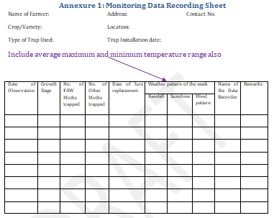

Slide 28
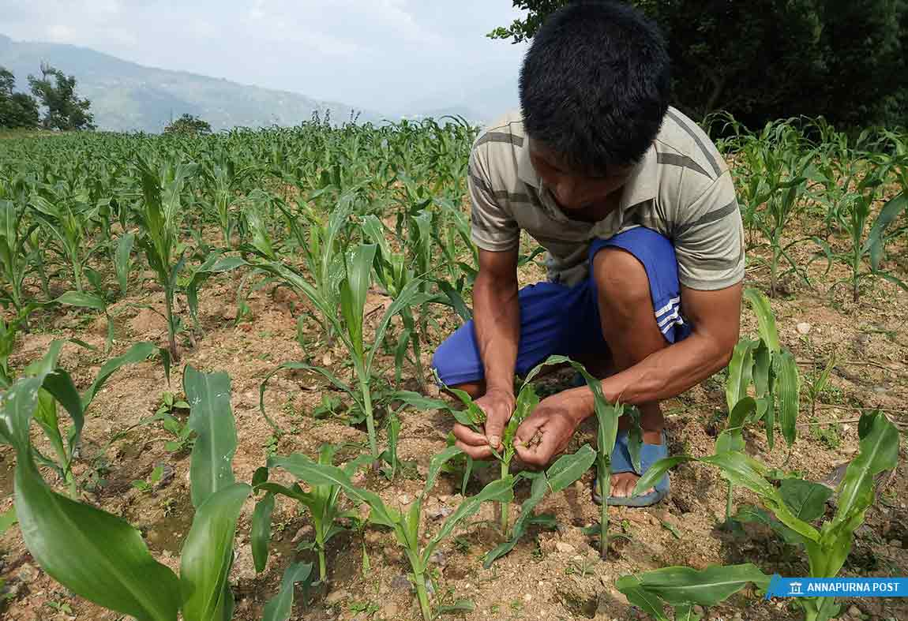
MAIZE FIELD SCOUTING FOR FAW LARVAE

Slide 29
MAIN PURPOSES OF SCOUTING FAW LARVAE IN MAIZE FIELD
EARLY DETECTION OF LARVAE IN MAIZE PLANTS.
POSSIBLY PERFORMING MECHANICAL CONTROL OF LIVE EGG MASSES AND EARLY INSTARS OF FAW LARVAE IN PLATS.
MAKING DECISION FOR CHEMICAL CONTROL OF EARLY INSTARS LARVAE BEFORE ENTERING INTO WHORL.
KNOWING FIELD STATUS OF CROP INFESTATION AND POPULATION DYNAMICS OF FAW.
KNOWING FIELD STATUS OF NATURAL ENEMIES OF FAW LARVAE AND PUPAE.
ASSISTING STAGE-WISE FORCATING FOR MANAGING FAW IN CROP.

Slide 30
Scout Your Field!!
Scout – Assess – Decide
Choose The Right Tools
Pre-Scouting (Prepare)
Host Plant Resistance
Cultural Controls & Landscape Management
Agronomics
Planting Date
Fertilizer & pH adjustment
Biocontrol (enhance)
Post-Scouting (Respond)
No Action
Mechanical control
Biocontrol (Inundative)
Pesticides
REMEMBER - The goal is NOT To Spray!
Damage Level = ET
Take Action
14

Slide 31
BEST TIME TO SCOUTING FAW LARVAE IN MAIZE FIELD
VISIT CROP FIELD TWICE A WEEK FOR THE FIRST 6 WEEKS, AND PERFORM MECHANICAL CONTROL OF EGGS AND EARLY INSTAR LARVAE AS AN EARLIEST PEST MANAGEMENT.
THE BEST TIME FOR SCOUTING IS THE MORNING 6 TO 10 O’CLOCK WHEN IT IS NOT TOO MUCH SUNNY.
IN THE AFTERNOON FROM 3 UP TO 6 O’CLOCK EVENING BECAUSE NOON MAY BE TOO HOT AND, IN THIS SITUATION, FAW LARVAE HID IN FILED THAT REMAINS DIFFICULT TO LOCATE THEM.

Slide 32
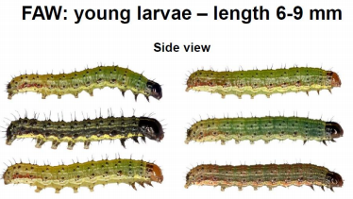
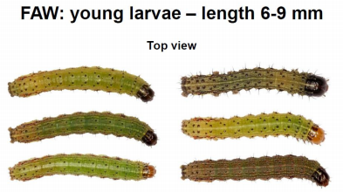
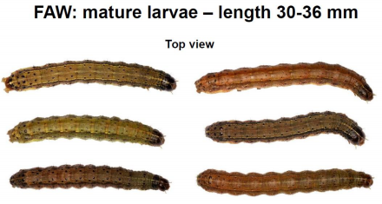
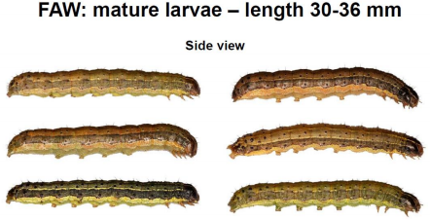
SOME POINTS TO KEEP IN MIND BEFORE
DEPLOYING FIELD SCOUTING
Know important identifying markings on insect body.

Slide 33
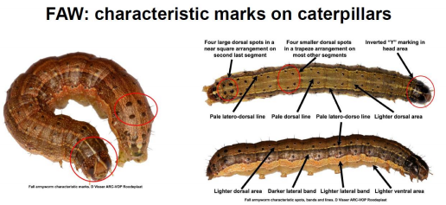
SOME POINTS TO KEEP IN MIND BEFORE
DEPLOYING FIELD SCOUTING
Know important identifying markings on insect body.

Slide 34
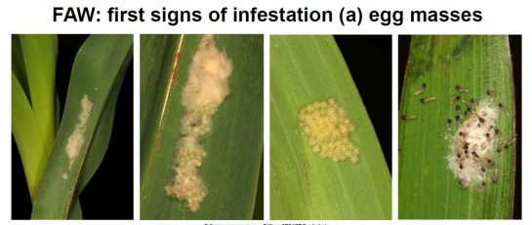
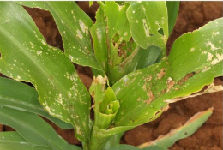
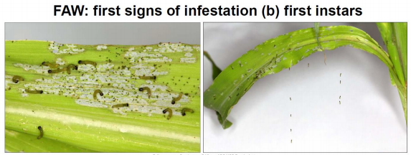
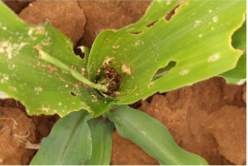
SOME POINTS TO KEEP IN MIND BEFORE
DEPLOYING FIELD SCOUTING
Know infestation symptoms in plant parts.
FAW: Signs of infestation
at a later stage

Slide 35
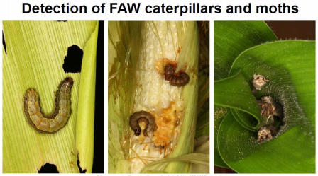
SOME POINTS TO KEEP IN MIND BEFORE
DEPLOYING FIELD SCOUTING
Caterpillars found in whorls of young maize plants.
Infest ears on mature plants where they feed on soft
tissue like kernels, soft inner leaves, and silk hairs.
Rarely feed on older mature leaves.
Moths hide in debris or in other secluded places on
the ground, as well as in whorls.

Slide 36
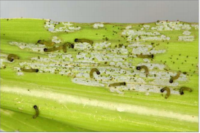
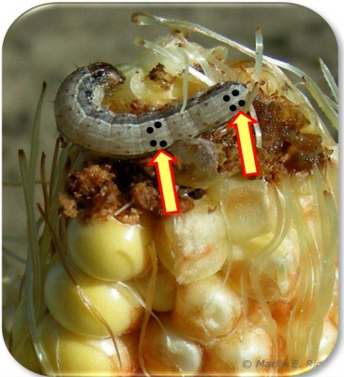
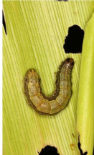
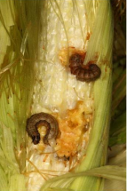
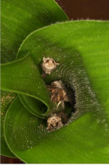
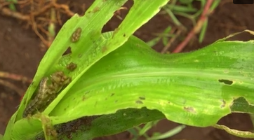
SOME POINTS TO KEEP IN MIND BEFORE
DEPLOYING FIELD SCOUTING
Know habitats of insect in plants and soil.
Tender leaves of young maize plants.
Soft inner leaves in whorls of maize plants.
Soft kernels and silk hairs in ears on mature plants.
Pupae in soil at root zone.
Moths hide in debris or in other secluded places on
the ground, as well as in whorls.

Slide 37
MAIZE FIELD SCOUTING FOR FAW LARVAE
Scouting involves rapid and systematic
determination of overall crop health and estimating
presence of FAW and potential yield reduction.
Scouting of crop field is necessary for the accurate
assessment of the level of infestation of FAW, and is
usually expressed as percentage (%) of infested
plants.
Scouting results are based on sampling.
The Fall Armyworm caterpillar attacks all growth
stages of maize i.e. seedling, vegetative, tasseling
and grain filling.
Scouting of the maize field should be started two
weeks after planting and be continued in every 3
days.
It is important to note that FAW caterpillars and
moths hide inside the maize whorl during the day
time.
.

Slide 38
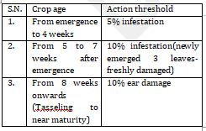
GROWTH STAGES AND ACTION THRESHOLD
Early age of the crop is more susceptible to FAW infestation thus action thresholds at different ages may differ.

Slide 39
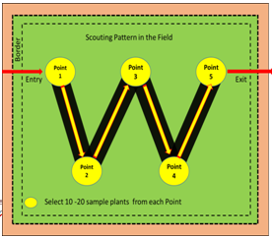
SCOUTING PATTERN
Scouting in the field is done in a semi systemic
manner. It is one of the approaches that follow a
"W“ pattern to cover the entire field.

Slide 40
SCOUTING PATTERN
While entering into the field for scouting, at least
two outer rows should be left. This is practiced to
avoid border effect.
At every point inspect 10 – 20 plants in a row or
around the central plant of the point (in case of
scattered planting).
Observe the signs in upper 3 leaves for the damage
or fresh frass (excreta) carefully in each plant. Fresh
frass indicates the presence of living larvae in the
whorl.
Record the infestation in all the points in observation
sheet and calculate the percentage infestation.

Slide 42
Thank You

